Slide 1
Magnetic Fields

Slide 2
Objective
Magnetic field review
Calculating the Magnetic Field Due to a Current – Biot – Savart law
Ampere’s Law
Magnetic Field Outside a Long Straight Wire with Current
Magnetic Field Inside a Long Straight Wire with Current

Slide 3
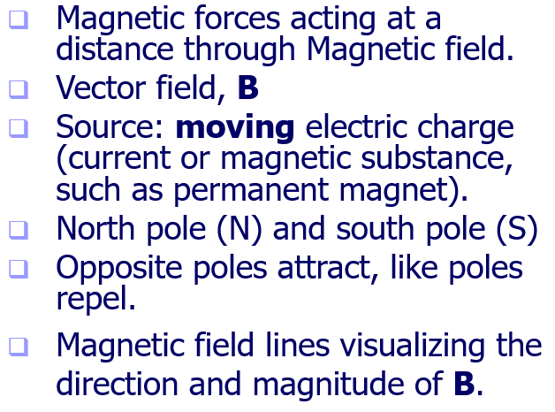
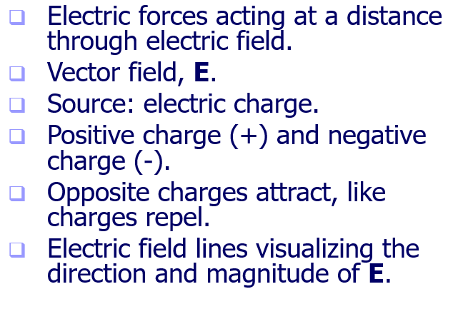
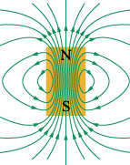
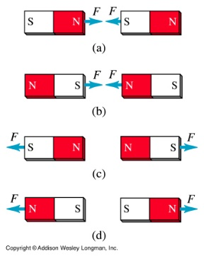
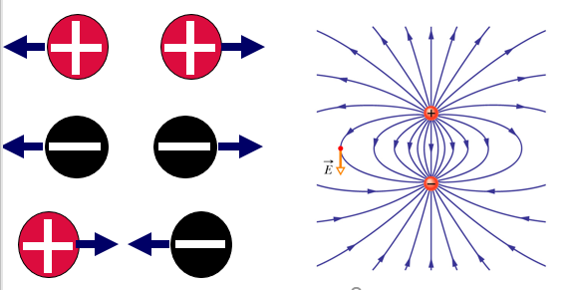
Electric Field & Magnetic Field
The magnetic field lines produced by a current in a long straight wire form concentric circles around the wire.

Slide 4
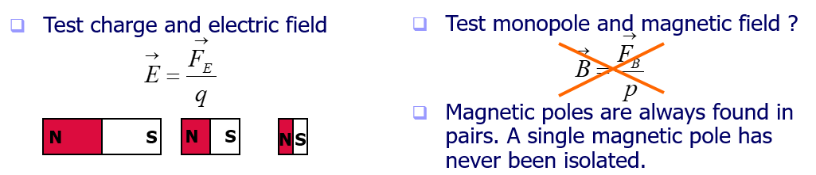
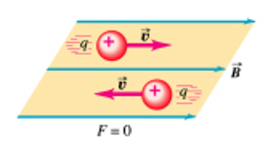
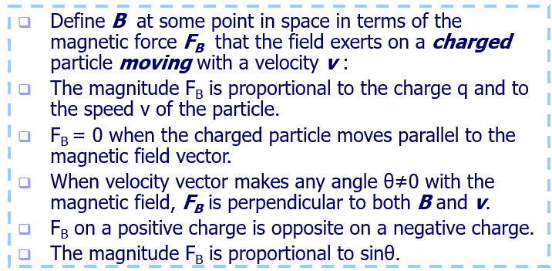
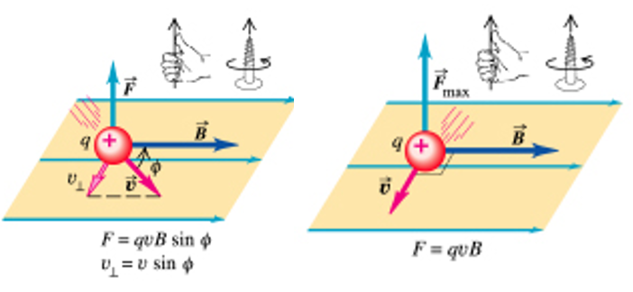
Electric Field & Magnetic Field

Slide 5
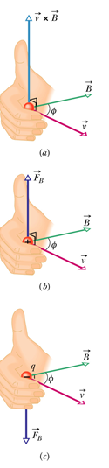
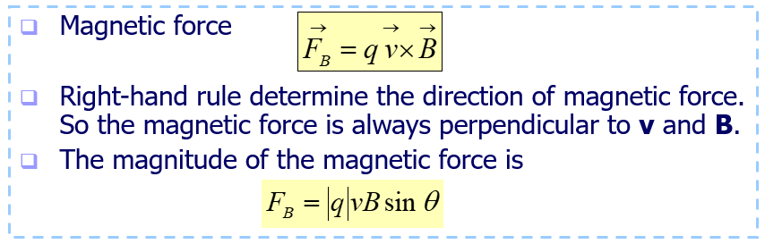
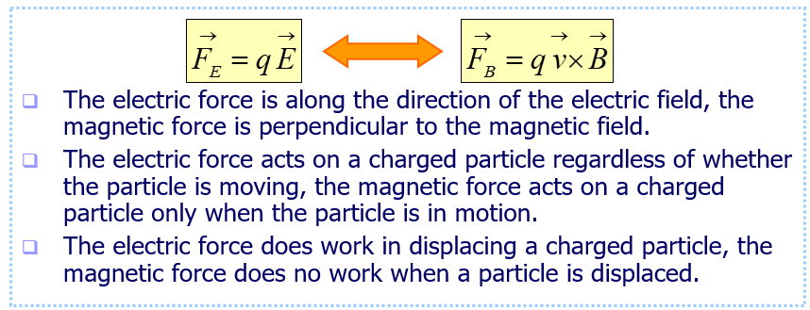
Magnetic Fields

Slide 6
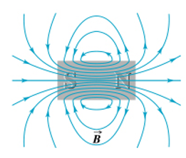
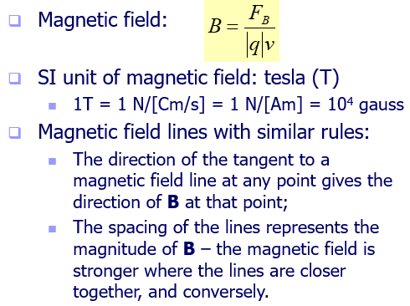
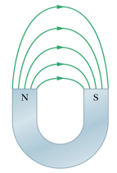
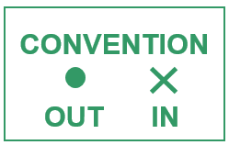
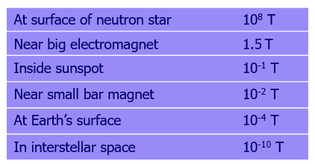
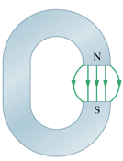
Magnetic Fields
Bar magnet
A horseshoe magnet
C-shaped magnet

Slide 7
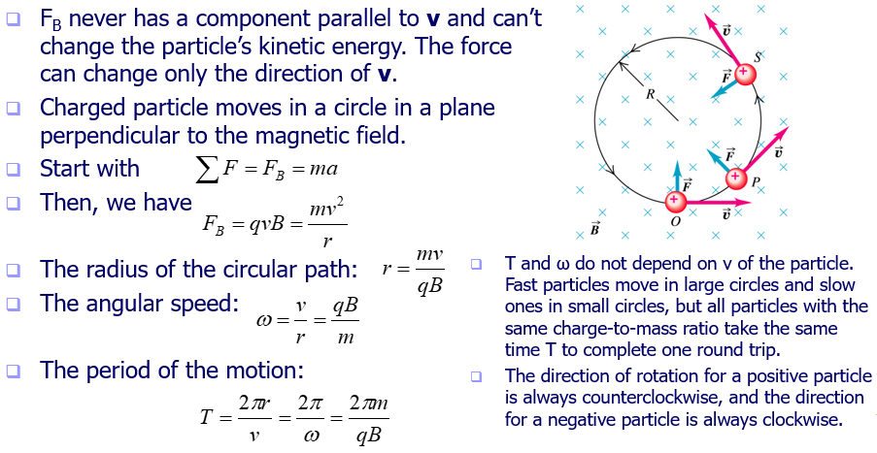
Motion of a Charged Particle in a Uniform Magnetic Field

Slide 8
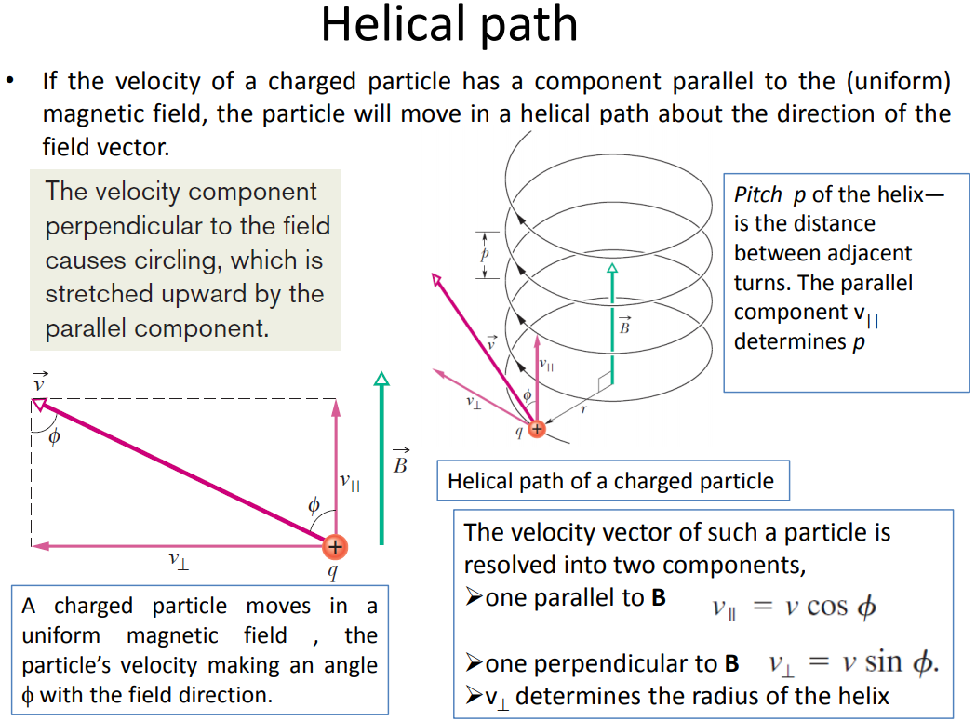

Slide 9
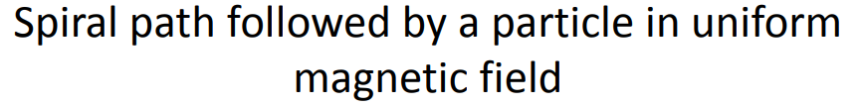
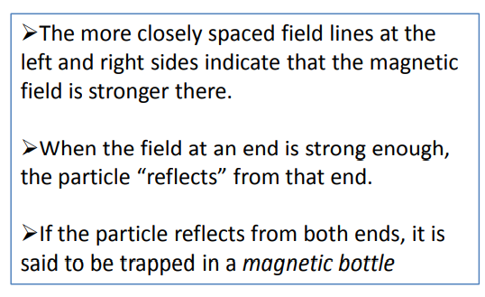
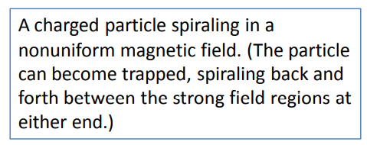

Slide 10
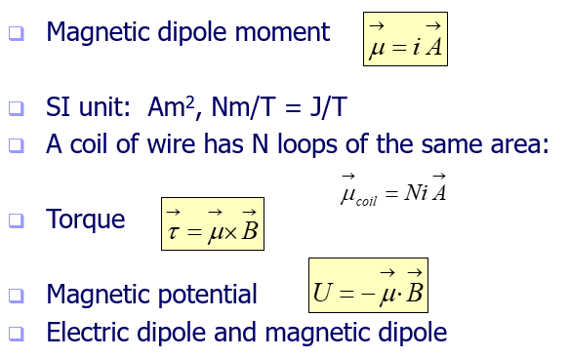
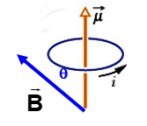
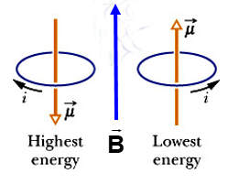
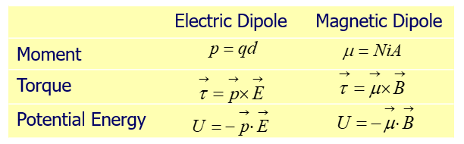
The Magnetic Dipole Moment

Slide 11
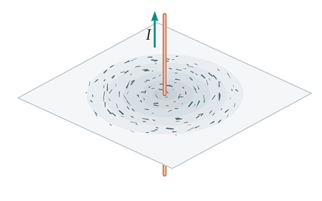
Magnetism and Electric Currents
To visualize the magnetic field produced by a wire, consider a long, straight wire that carries a current, I.
Shaking iron filings onto a sheet of paper that is pierced by the wire results in a circular pattern of filings centered on the wire (see figure (a) below). Clearly, the magnetic field "circulates" around the wire.

Slide 12
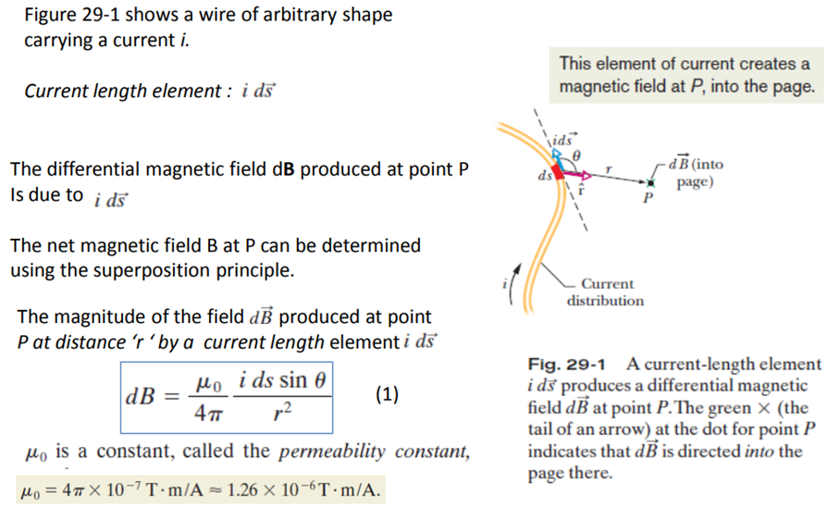

Slide 13
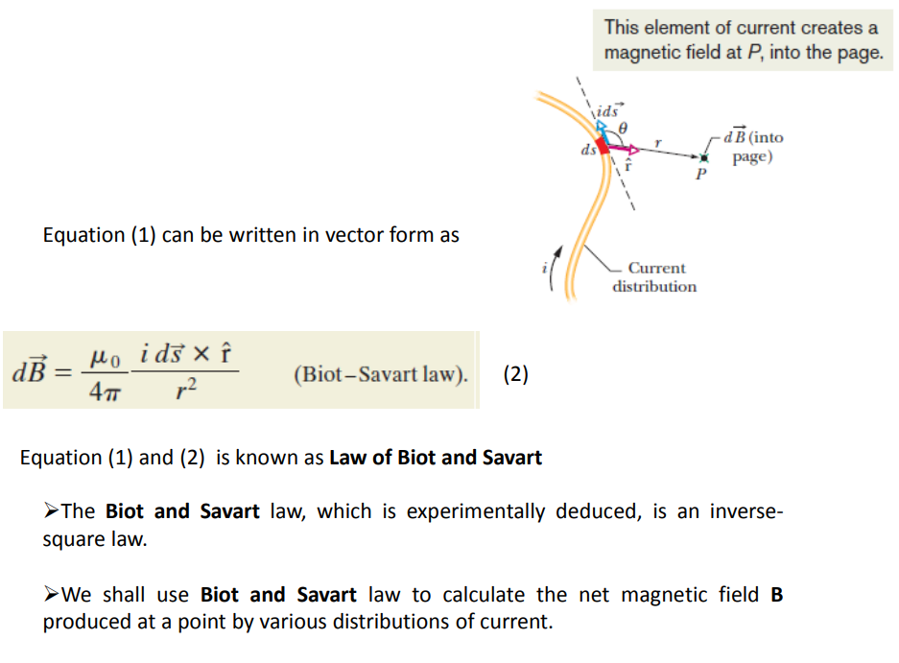

Slide 14
A conductor in the shape of a square loop of edge length ℓ = 0.400 m carries a current I = 10.0 A as in the figure.
(a) Calculate the magnitude and direction of the magnetic field at the center of the square
(b) If this conductor is formed into a single circular turn and carries the same current, what is the value of the magnetic field at the center?

Slide 15
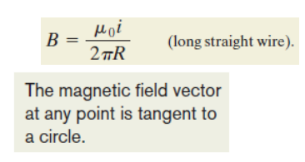
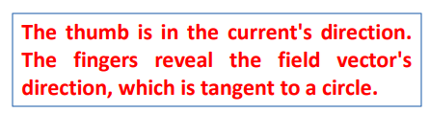

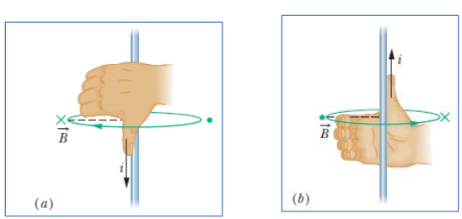
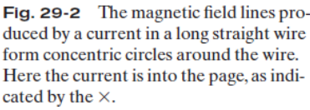
(a) The magnetic field B at any point to the left of the wire is perpendicular to the dashed radial line and directed into the page, in the direction of the fingertips, as indicated by the ×
(b) If the current is reversed, B at any point to the left is still perpendicular to the dashed radial line but now is directed out of the page, as indicated by the dot.

Slide 16
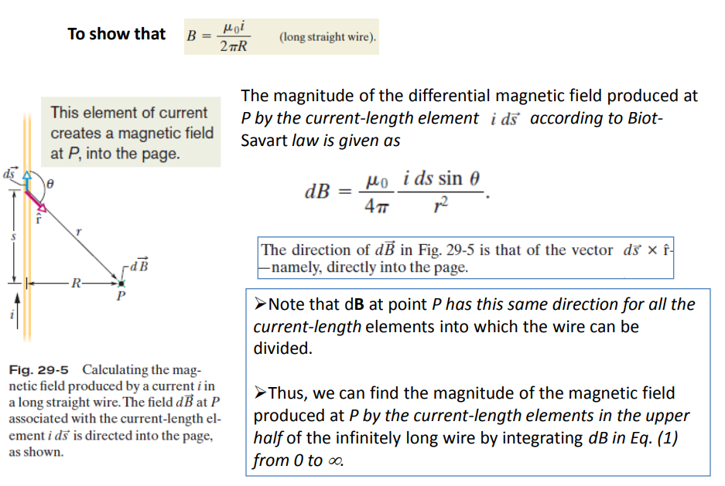

Slide 17
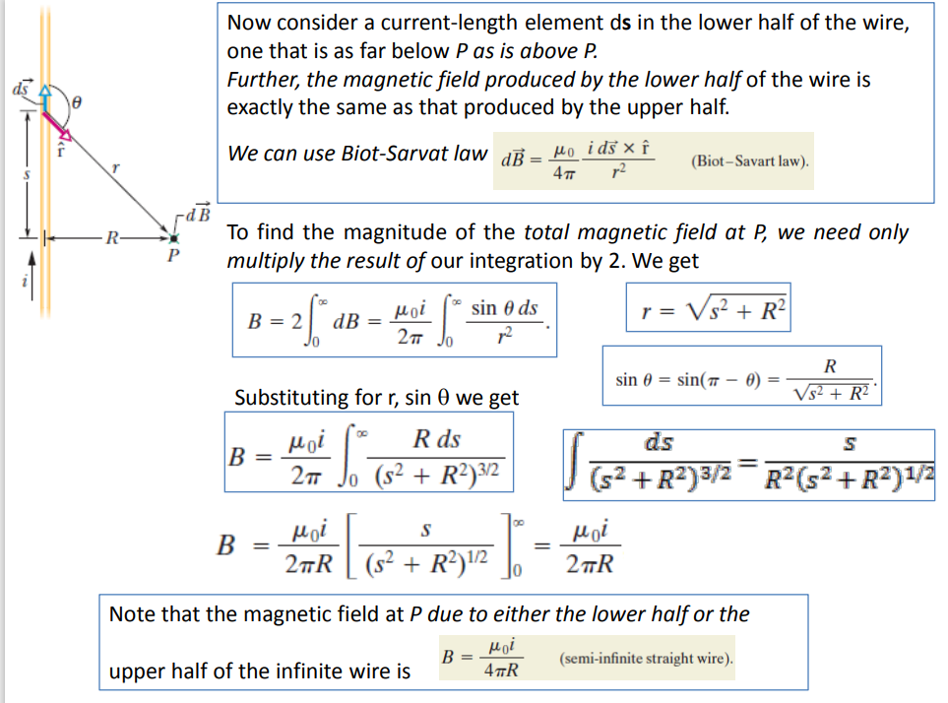

Slide 18
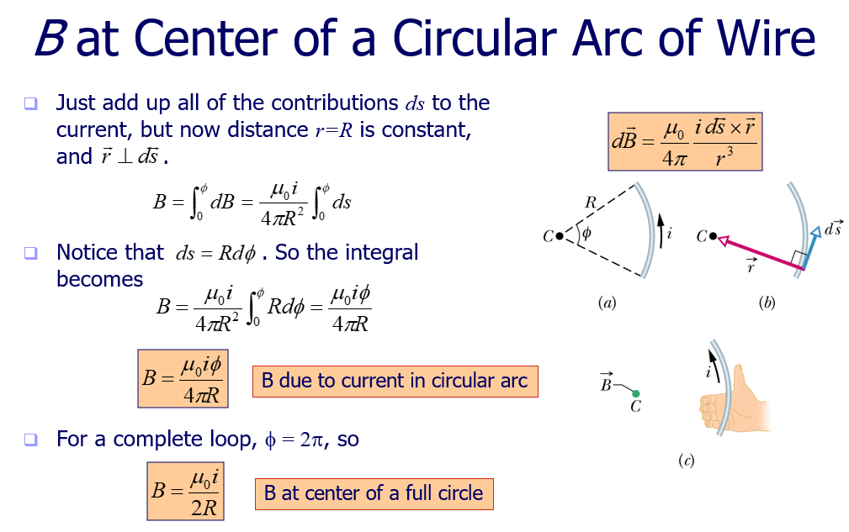

Slide 19
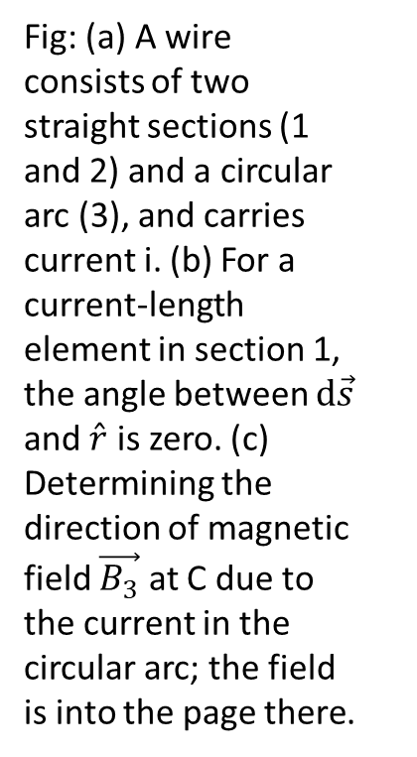
Calculating the Magnetic field at the center of a circular arc of current using Biot and Savart law
Fig: (a) A wire consists of two straight sections (1 and 2) and a circular arc (3), and carries current i. (b) For a current-length element in section 1, the angle between $d\vec{s}$ and $\hat{r}$ is zero. (c) Determining the direction of magnetic field $\vec{B_{3}}$ at C due to the current in the circular arc; the field is into the page there.

Slide 21
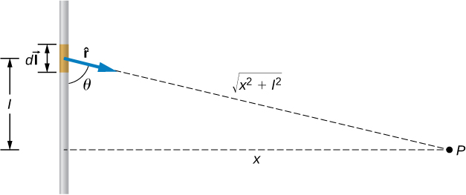
A short wire of length 1.0cm carries a current of 2.0A in the vertical direction. The rest of the wire is shielded so it does not add to the magnetic field produced by the wire. Calculate the magnetic field at point P, which is 1m from the wire in the x-direction.

Slide 22
Ampere’s Law
Net electric field E due to any distribution of charges by first writing the differential electric field due to a charge element and then summing the contributions of from all the elements.
However, if the distribution has planar, cylindrical, or spherical symmetry, we can apply Gauss’ law to find the net electric field and this simplifies the calculation of electric field.
Similarly, the net magnetic field B due to any distribution of currents by first writing the differential magnetic field due to a current-length element as
and then summing the contributions of from all the elements.
However, if the distribution has some symmetry, Ampere’s law can be applied to find the magnetic field B and this simplifies the calculation of B.

Slide 23
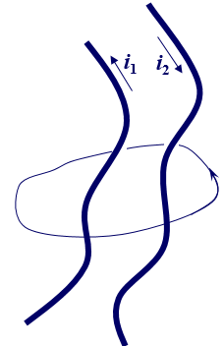

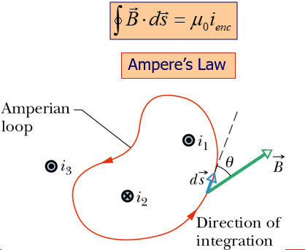


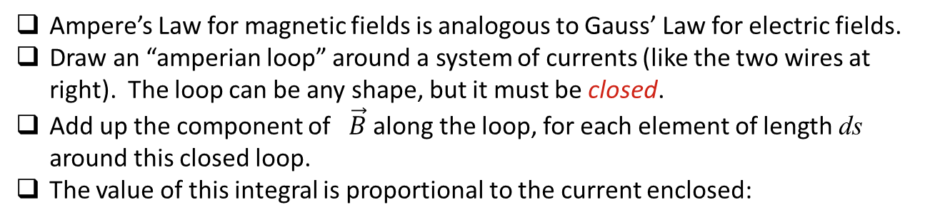
Ampere’s Law
Ampere’s Law for magnetic fields is analogous to Gauss’ Law for electric fields.
Draw an “amperian loop” around a system of currents (like the two wires at right). The loop can be any shape, but it must be closed.
Add up the component of $\vec{B}$ along the loop, for each element of length ds around this closed loop.
The value of this integral is proportional to the current enclosed:
A right-hand rule for Ampere’s law, to determine the signs for currents encircled by an Amperian loop.
Curl your right hand around the Amperian loop, with the fingers pointing in the direction of integration.
A current through the loop in the general direction of your outstretched thumb is assigned a plus sign, and a current generally in the opposite direction is assigned a minus sign.

Slide 24
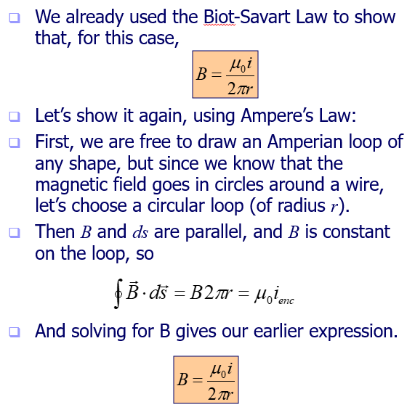
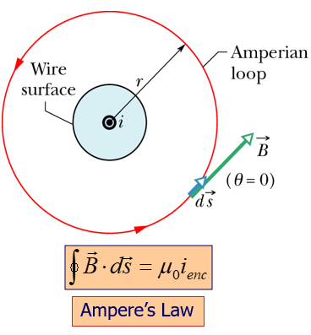
Magnetic Field Outside a Long Straight Wire with Current - Ampere’s Law

Slide 25
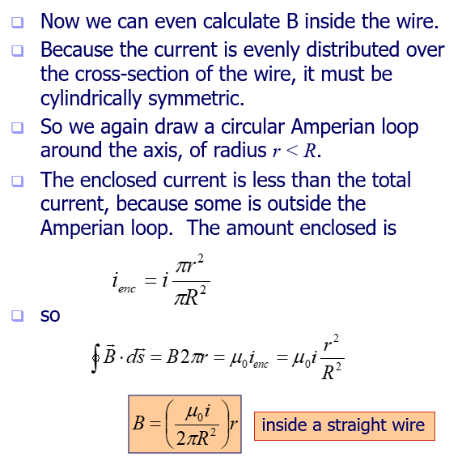
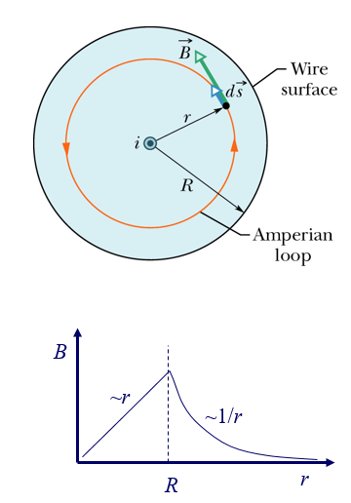
Magnetic Field Inside a Long Straight Wire with Current - Ampere’s Law
Thus, inside the wire, the magnitude B of the magnetic field is proportional to r, is zero at the center, and is maximum at r = R (the surface).

Slide 26
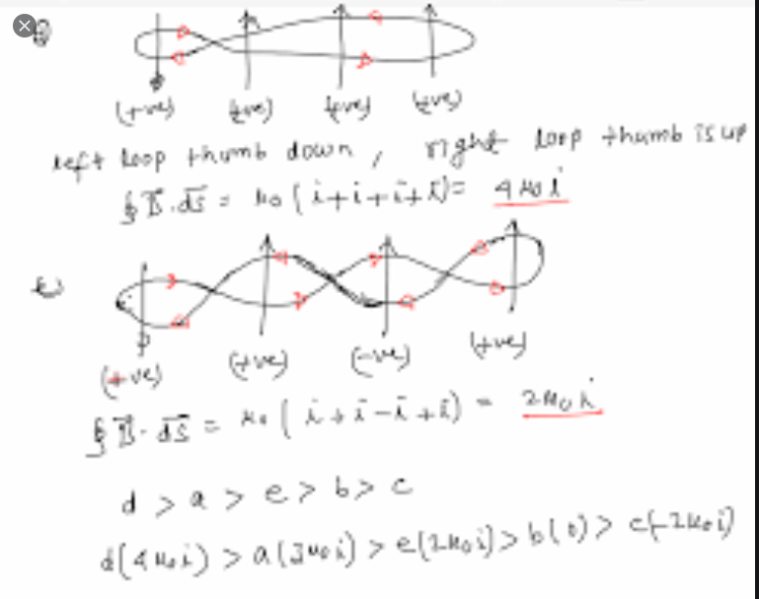

Slide 27
